Slide 1
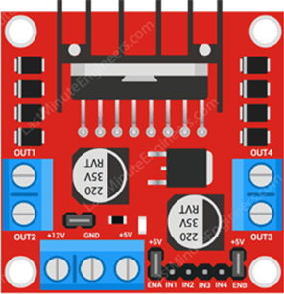
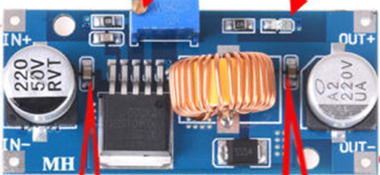
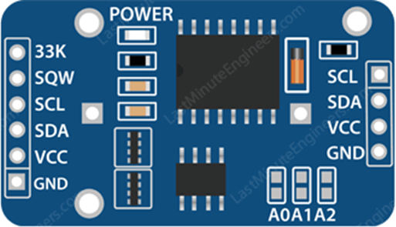
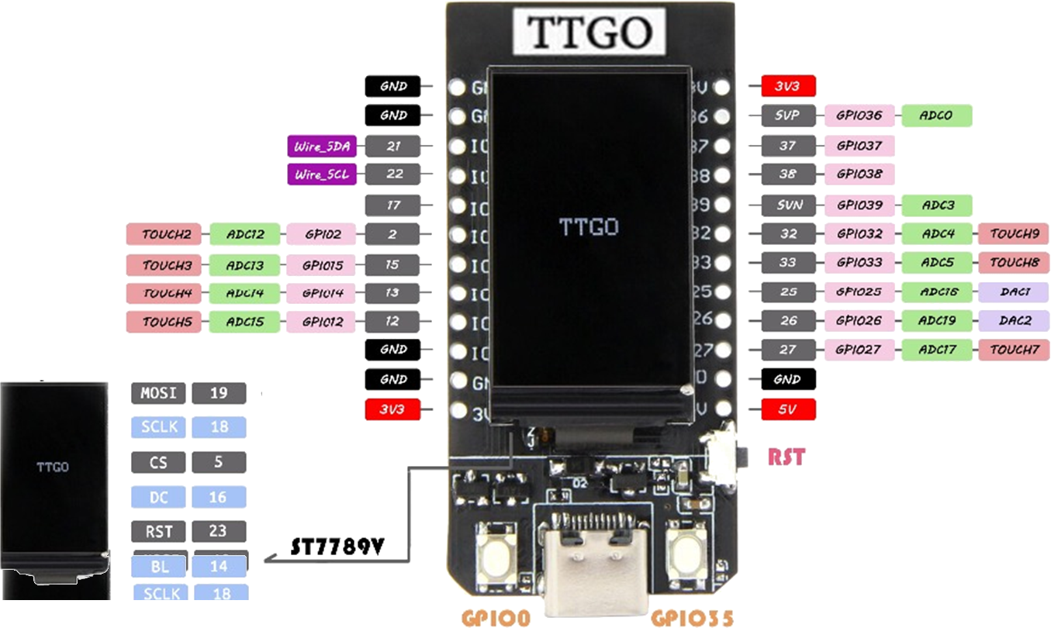
24V in
M3 by 2
Motor
24-pin SIL only
M3 by 4
M2.5 by 3
Rear access needed (battery)
Could mount on pins

